Slide 1
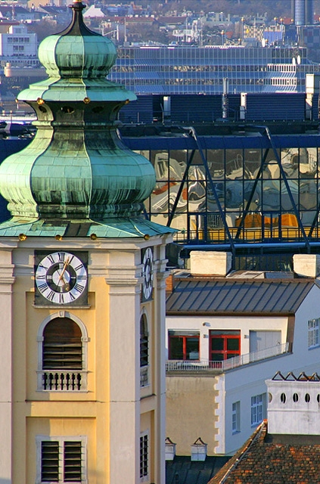
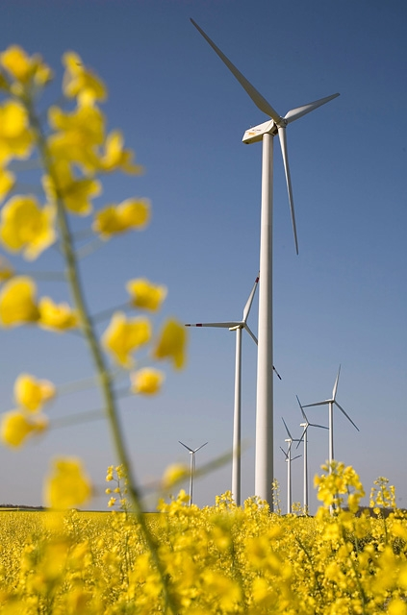
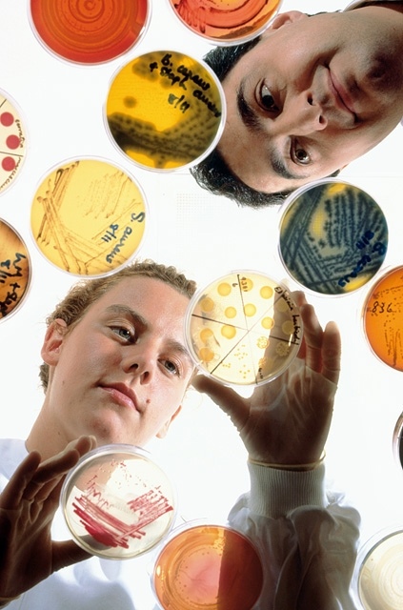
*) Where your profits climb to the top
Austria *

Slide 2
Austria – Investment climate
Reasons to invest in Austria - perspectives
Peter Ch. Löschl
ABA – Invest in Austria April 2015

Slide 3
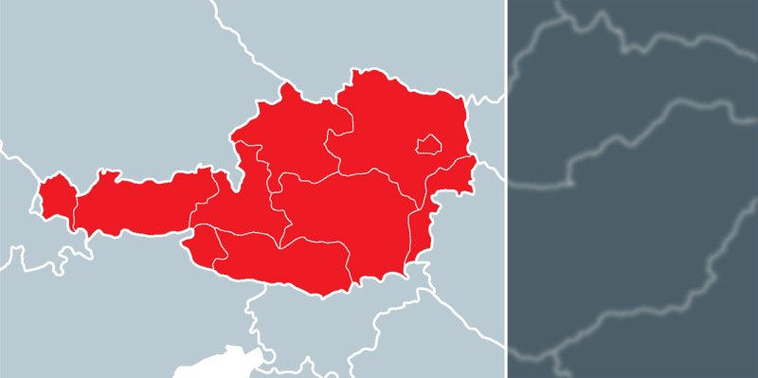
Facts about Austria: Economy in 2013
Population | 8.4 mio
GDP growth | + 0.6 %
GDP/capita | € 33,660
Inflation | 2.1 %
Public Debt | 74% of GDP
Government Deficit | - 2.5%
Unemployment | 5.1%
Trade balance Capital balance | + 5.5 bn. - 5.0 bn.
GDP Industry GDP Services GDP Agriculture | 28.2 % 68.8 % 1.4 %
Russian invest | 10,4bn € (stock 2013)
…#2 in the EU in 2013 with GDP/capita
Source: Eurostat, Statistics Austria

Slide 4
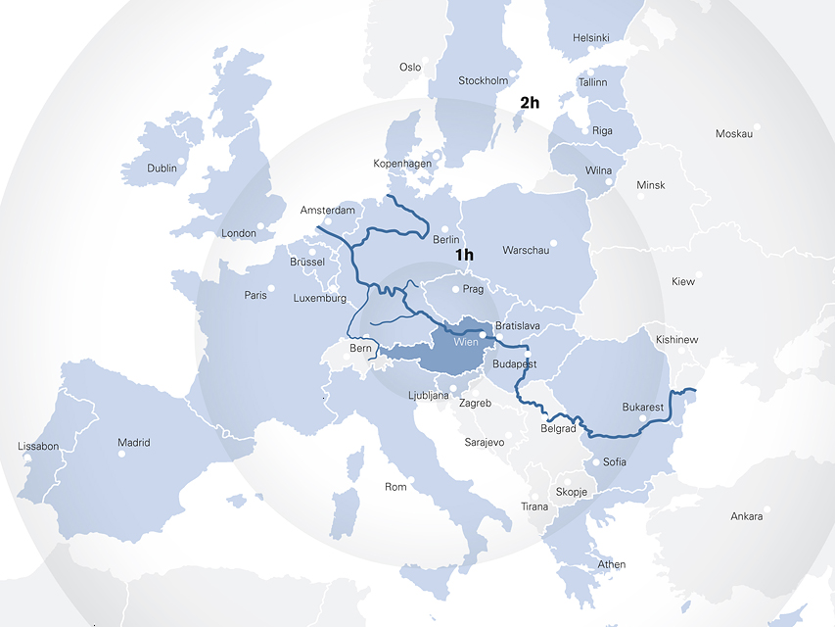
Ideal Location in the Heart of Europe
Ideal access to CEE and WE markets
Excellent infrastructure
Austrian services providers have extensive CEE know how

Slide 5
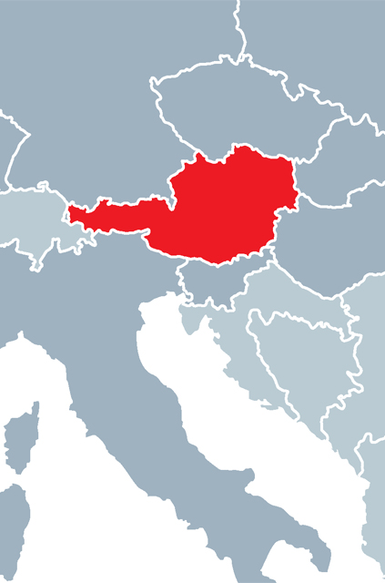
Top Investor:
Austrian FDI in CEE and SEE
Percentage of total investment in resprective country and Austria‘s rank as an investor, 2013
Source: WIIW (Vienna Institute for International Economic Studies) 2014

Slide 6
Top Investor:
Russian FDI in Austria
Source: Austrian Nationalbank 2014

Slide 7

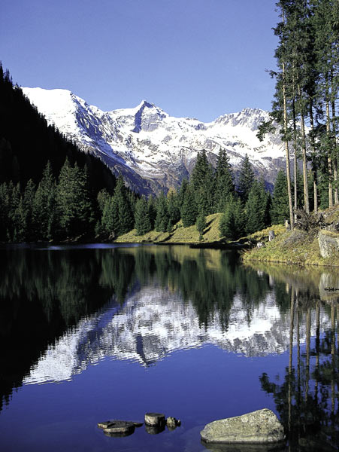
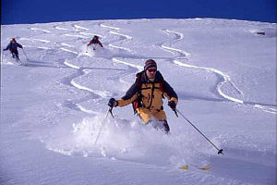
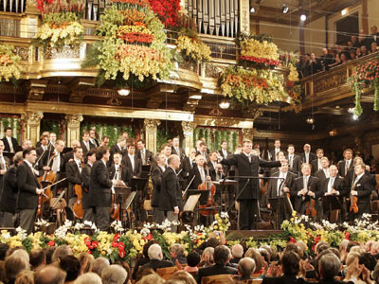
You Know Austria Like This …
Notes:
Secondo posto mondiale per quanto riguarda la qualità della vita, la citta di Vienna è al primo posto
Settore turistico è importante, sul livello mondiale il piccolo Austria è il nono mercato turistico, in Europa il sesto. Solo nel Tirolo ci sono piu di 40 Mio. di pernottamenti di stranieri annuali, tutta la Grecia ne ha 47 Mio.
In kaum einem anderen Land der Welt sind die Tourismuseinnahmen so hoch wie in Österreich. Mit 1.657 Euro Deviseneinnahmen pro Kopf liegt Österreich international auf Platz 2 (hinter Zypern). Weltweit ist das kleine Österreich der neuntgrößte Tourismusmarkt, innerhalb Europas sogar der sechtgrößte.
Allein in Tirol gibt es pro Jahr knapp 40 Mio. Nächtigungen von Ausländern, in ganz Griechenland werden pro Jahr ca.47 Mio. Nächtigungen von Ausländern verzeichnet.

Slide 8
You Are Investing in an Industrial Country
Production sectors as percentage of GDP, 2013
Elements of GDP in %
Quelle: Statistik Austria
Quelle: OECD, Eurostat 2014

Slide 9
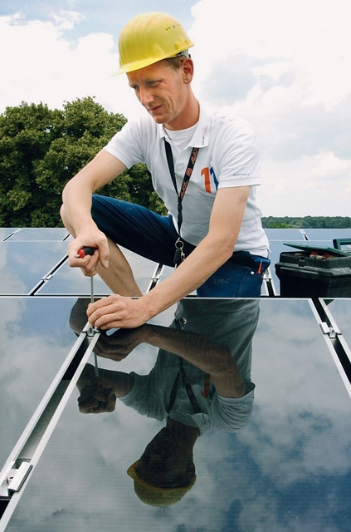
19% „New“ Austrians
Foreign citizens
Already naturalized
226,882
208,947
185,592
132,661
74,639
69,859
63,197
45,589
44,209
30,017
28,510
27,916
Source: Statistics Austria 2013
Notes:
Investment in people
backbone of Austria’s success:
Educated, motivated and very productive people
Austria is ranked top in the world in terms of availability of highly educated and skilled labour among leaders in the EU for quality of educational system
Flexible and creative workforce.

Slide 10

Motivated Workforce
10=Employees identify with company goals
Source: World Competitiveness Yearbook 2014

Slide 11
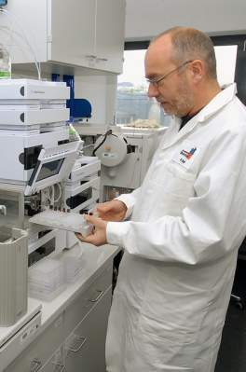
Highly Productive Employees
Labor productivity: GDP per person employed in PPS, EU-28=100
Source: European Commission, Eurostat 11/2014

Slide 12

Expert Staff for Sustainable Corporate
Success in R&D
Dual educational system
Vocational schools (HAK, HTL unique to Austria)
21 Academies of applied sciences with offering more than 370 courses
22 public universities
11 private universities
Foreign language competencies
More than 1,000 extra-university research institutions
Notes:
12

Slide 13
No Strikes
Working days lost to strikes per 1,000 employees – annual average 2005-2012
Source: WSI – Hans Böckler –Stiftung 2014

Slide 14

Moderate Taxation on Corporate Profits
2014 in %
Source: Deloitte Resources
Notes:
14

Slide 15

Austria‘s R&D Expenditures Grow above Average
As a percentage of GDP
*Forecast 2014
2,9
2.88 *
2,7
Germany
Austria
2,5
2,3
2,1
1,9
EU-25
1,7
1,5
1998
2000
2003
2004
2005
2006
2007
2008
2010
2012
2014
Source: Eurostat
Notes:
Cooperation between research and economy
EUR 8.4 billion in 2011
55 % public funding, 45 % private
More than 9.000 foreign owned companies in Austria - 52 % pf R&D expenditure in Austria!
Over 5.000 Austrian owned companies abroad (41 % Germany, 12 % Switzerland, 6 % Hungary, 5 % USA, Netherlands, 4 % in UK)

Slide 16
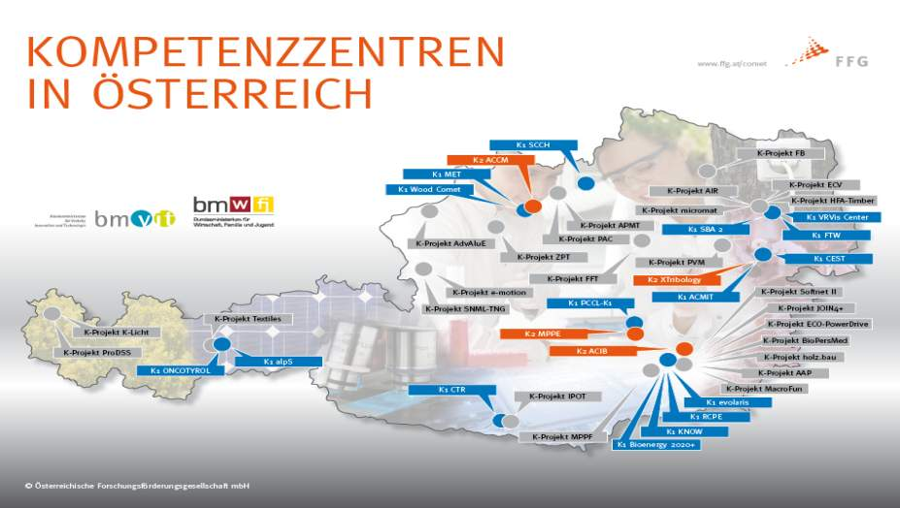
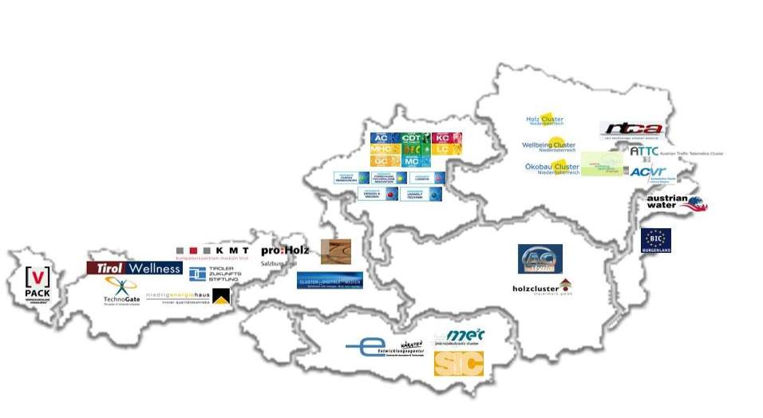
COMET – all Centres Industrial Clusters in Austria

Slide 17
Subsidies for R&D projects are available via two main programm lines
„Top Down“
Thematic calls
„Bottom-up“
Any topic
Any time
„Basic programme“
„Special programmes“

Slide 18
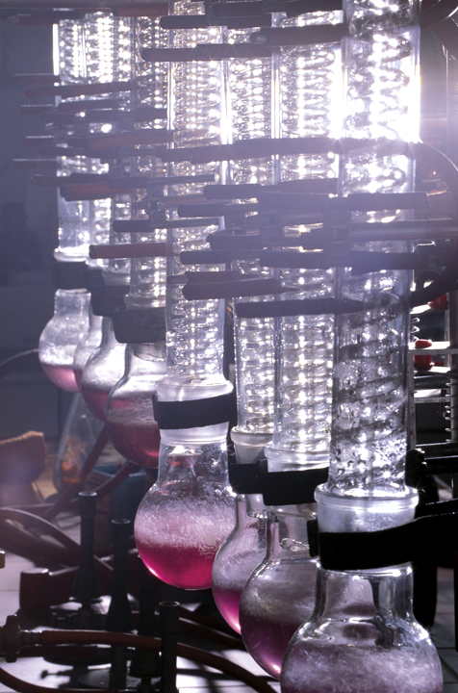
Austrian Expenditures in R & D
2014 in €
Total: 9,322.26 m
Source: Statistik Austria
Notes:
18

Slide 19
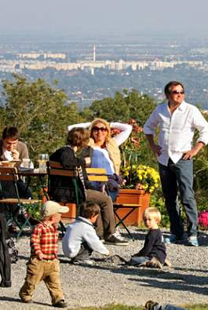
Unmatched Quality of Life
Maximum = 10
Source: World Competitiveness Yearbook 2014
Notes:
19

Slide 20
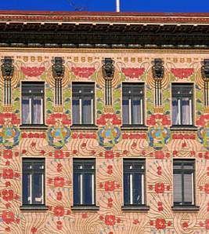
Economic and Social Stability
Reliable legal system
Efficient public administration
High personal security
Very low strike rate
Notes:
20

Slide 21
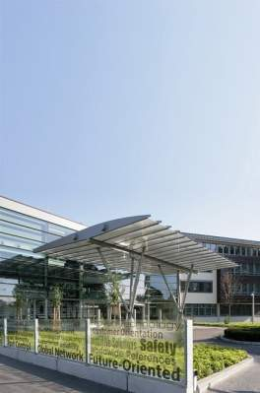
Competitive Office Rents Reduce
Your Operating Costs
In Euro per m² and year
Source: CB Richard Ellis, 2014
Notes:
Yet investors appreciate Austria‘s stability and attractiveness (annual return of 4.75 %)
No real estate bubbles ( well-financed expansion
(More than) 50 % equity (private homes)
Rent from EUR 100 p.a. up / m²

Slide 22
























Attractive for More than
300 Regional Headquarters
Sberbank
Notes:
22

Slide 23
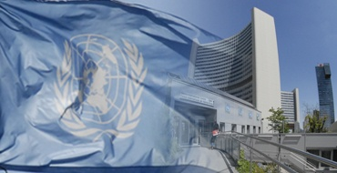
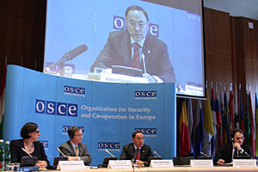

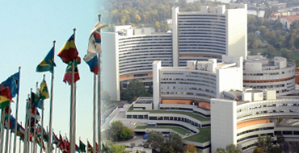
Vienna: HQ-Location for International Organizations & Top Conference City
Vienna: Only UN headquarters in the EU
  UN organizations in Vienna:
  UNCITRAL, UNODC, UNIDO, UNIDIR, CTBTO, UNHCR, OIOS, IMOLIN, etc
30 HQs of international organizations in Vienna
More than 14,000 international staff and diplomats (UN) are living in Vienna
Leading conference city (according to ICCA study)
Skilled HQ staff available
Notes:
23

Slide 24

HQ Locations in Comparison
Number of regional headquarters
Source: Wolf Theiss, Headquarters Austria, September 2011

Slide 25
CEE Stock Exchange Group –
New Holding Structure
Holding
CEE Stock Exchange Group*
50.45 %
100 %
92.74 %
100 %
Budapest
Stock Exchange
Hungary
Ljubljana
Stock Exchange
Slovenia
Prague
Stock Exchange
Czech Republic
Vienna
Stock Exchange
Austria
* Ownership of the CEESEG AG: 52.59% Austrian banks, 47.41% issuers of the Vienna Stock Exchange

Slide 26
Global Financial Centres Index illustrates attractiveness of the Austrian capital market
 | Ranking September 2014
London | 2
Zurich | 7
Geneva | 13
Luxembourg | 15
Frankfurt | 16
Monaco | 29
Vienna | 30
Paris | 31
Stockholm | 35
Munich | 37
Amsterdam | 39
Istanbul | 42
Milan | 48
Glasgow | 50
Rome | 55
Brussels | 56
Oslo | 57
Copenhagen | 60
Jersey | 62
Prague | 63
Isle of Man | 64
Edinburgh | 65
Guernsey | 67
Warsaw | 68
Dublin | 70
  Vienna currently ranks 30th out of 80 worldwide financial centres
  Within Europe Vienna even ranks number 7 out of 35 financial centres
  This reflects the stable economic environment in Austria
  The financial market of Vienna has an established position as a regional player and is ahead of cities like Paris, Munich, Milano, Brussels and Warsaw
Source: Z/Yen Group / City of London – September 2014

Slide 27
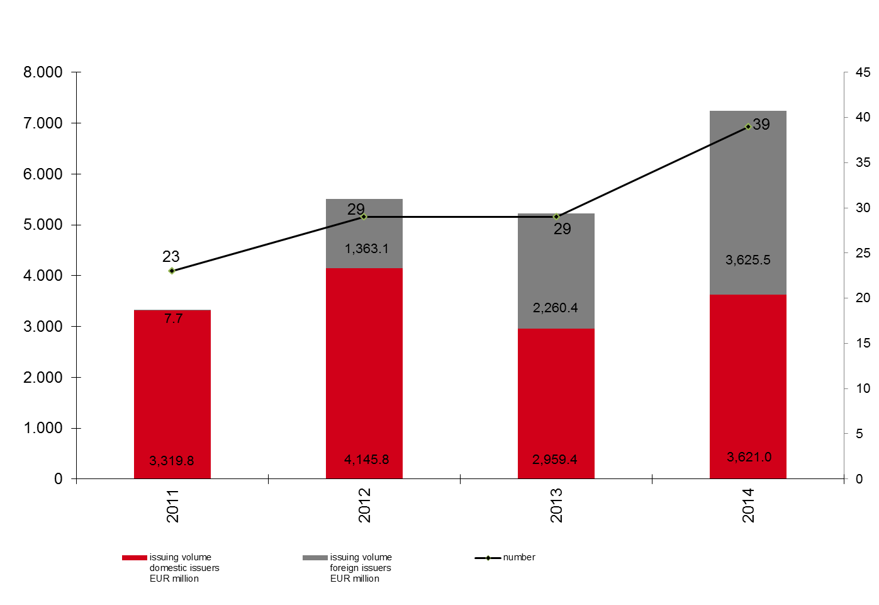
Corporate Bonds –
Boom at the Vienna Stock Exchange
Dezember 2014
Source: Wiener Börse AG

Slide 28
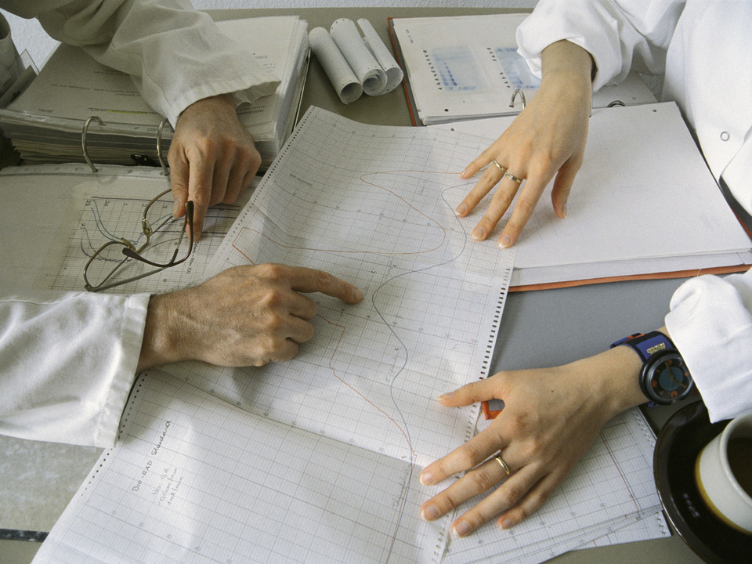
ABA-Invest in Austria
Opportunities are our business
Advisory services for international investors
Owned by the Republic of Austria
25 expert staff
International & national networks
Offices in Tokyo & Shanghai
Notes:
Austrian Business Agency
Federal inward investment agency (MOEA)
2 overseas offices (Tokyo and New York)
Information on:
Austrian business climate
Tax and labor regulations
Potential suppliers
Identify suitable office space and site locations
Assistance with government authorities
► make it easy for investors in Austria

Slide 29
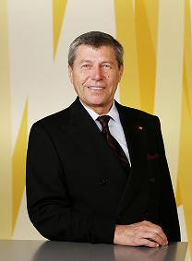
ABA-Invest in Austria
Your contact in Vienna:
Peter Ch. Löschl
Tel.: +43 1 588 58 52
E-Mail: office-cee@aba.gv.at
www.investinaustria.at

